Slide 1
USDA AMS Dairy Data Presentation
By: Jessie Justice

Slide 2
Purpose
Analyze monthly dairy production and pricing using historical data.
Understand the relationship between various types of dairy data (Milk, Class III and, Cheese).
Understand the basic structure of dairy data (i.e. trend, seasonality, etc.).
Understand driving factors behind changes in dairy product markets.
Discuss potential analysis/modeling techniques and future directions.

Slide 3
Terminology and Units of Measurement
Hundredweight (cwt) - A unit of measure that is equal to 100 lbs
Commodity Good - A good sold for production or consumption as it was found in nature (i.e. Milk, Eggs, Gold, Crude Oil)
Intermediate Good - A good used in the production of a final/finished good
Own-Price Elasticity of Demand - Measure of how responsive demand is to changes in price for the same product
Economies of Scale - Cost advantages a company gains with an increase in production

Slide 4
Economic Theory and Dairy Markets
Theory has typically asserted that commodity goods have relatively inelastic demand given there are few (or no) substitutes for these goods and thus demand is unresponsive to price changes.
Historically, dairy demand has been relatively inelastic.
Chouinard et al (2010) finds that the own-price elasticity of demand for milk and cheese products is less than 1, indicating that demand is (generally) relatively inelastic for dairy products when analyzed using scanner data from 1997-1999.
Other studies have found mixed results depending on data source, though most depend on similar estimation approaches and data sources (scanner data).

Slide 5
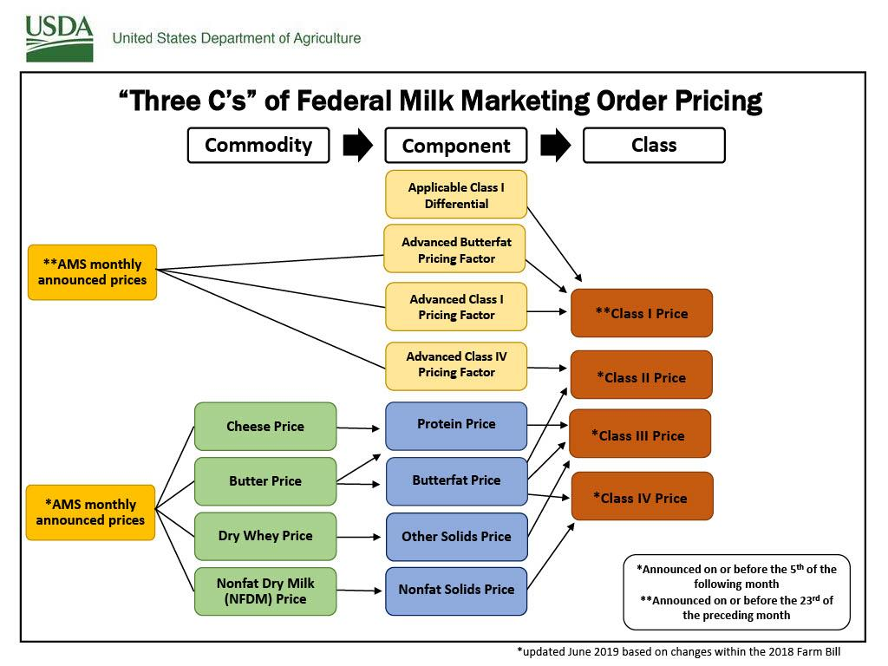
Economic Theory and Dairy Markets
Class III Milk is milk used in the production of cream cheese, hard cheese and, a variety of other related products (butteroil, anhydrous milkfat, etc.).
Class III Milk prices are determined formulaically and depend positively on Cheese prices.
Cheese Prices (Commodity) enter Protein Value in Cheese and Butterfat Value in Cheese positively, both of which enter Protein Price (Component) positively.
Given the hierarchical relationship between Milk, Cheese and, Class III Milk we can hypothesize that when Milk prices increase, Cheese prices will increase and, therefore the Cheese input to the Class III Milk formula will increase.

Slide 6
Data Sources
This analysis depends on three data sources that are based on the National Dairy Product Sales Report.
Milk Production and Pricing Data
Frequency: Monthly
Variables: Milk Price ($/cwt), Milk Production (lbs), Year, Period
Class III Milk Pricing Data
Frequency: Monthly (sometimes two reports in same month)
Variables: Class III Milk Price, Week Ending Date
Cheddar Cheese Pricing and Sales Data
Frequency: Weekly
Variables: Cheddar (40 lb block) Weighted Price, Cheddar (40 lb block) Sales, Cheddar (500 lb barrel) Weighted Price, Cheddar (500 lb barrel) Sales

Slide 7
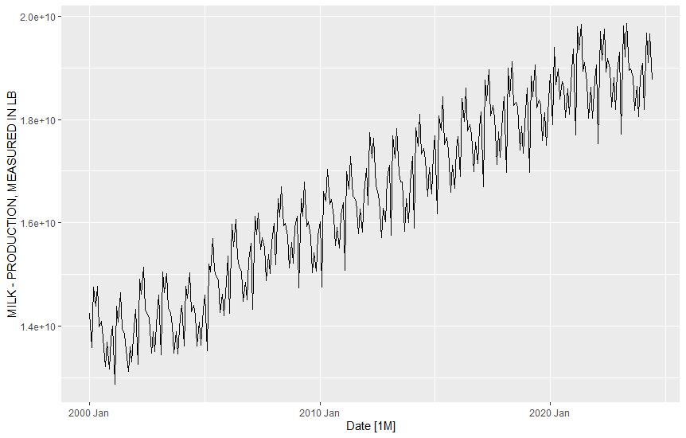
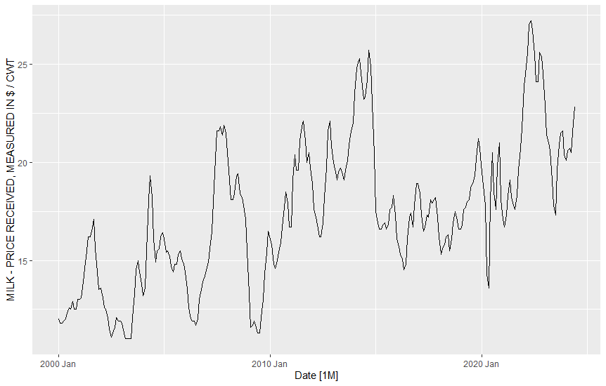
Milk Production and Pricing

Slide 8
Milk Production and Pricing
We can note a clear positive trend in production of milk over the past two decades, this is largely the result of 1.) changing technology and 2.) consolidations,
As small farms consolidate to form larger dairy operations they become more efficient and benefit from larger herd size and production facilities and thus can produce milk at a lower average cost per pound.
As technology (production technology, genetics, etc.), making it possible to produce a greater amount of milk per cow.
We can also note strong and consistent seasonality in milk production,
We can see that milk production is low in early Winter and during the Summer, this is likely due to the fact that cows eat less in the Winter and experience heat stress during the Summer, explaining the sharp decreases we observe.
We observe peak milk production in the spring during “Milk Flush” when lactation is peak.
So, why are prices so volatile?
Inelastic demand paired with a milk shortage could drive prices up quickly
Global political and economic factors (i.e. In the early 2010s China was buying a lot of dairy products from the United States, exports increased which drove up domestic prices)

Slide 9
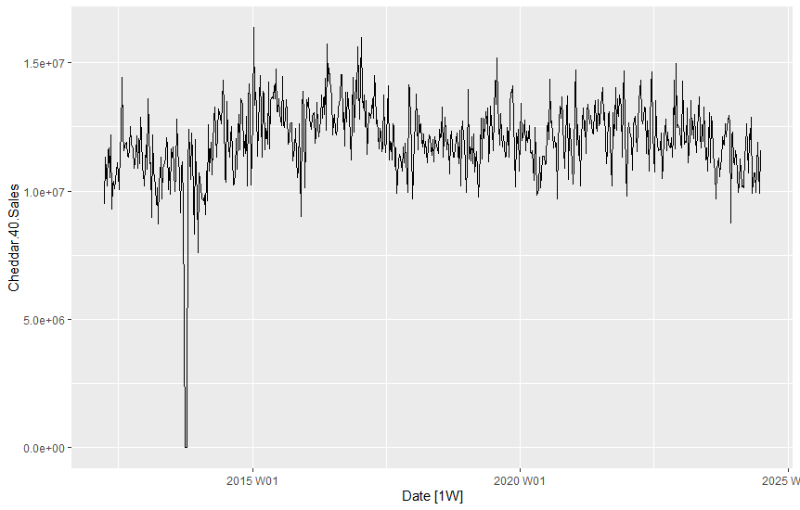
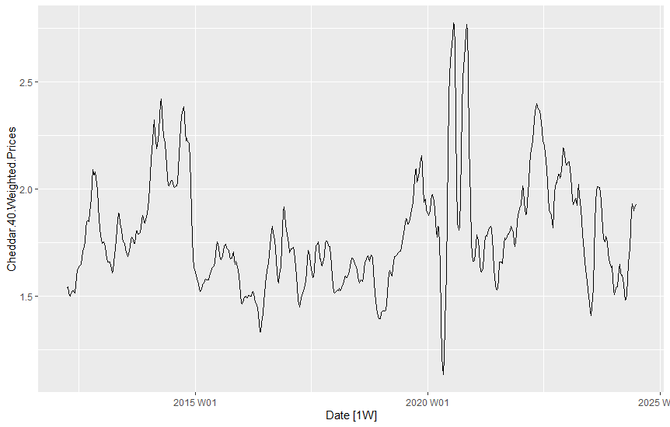
Cheddar (40 lb block) Sales and Pricing

Slide 10
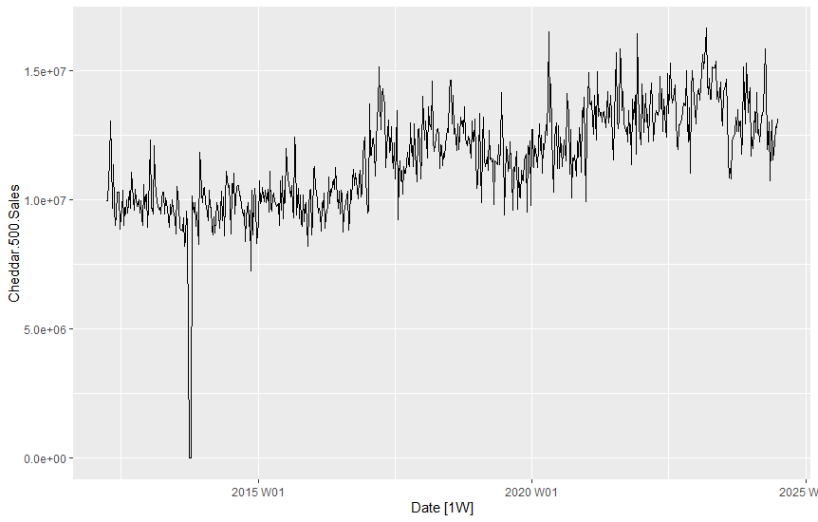
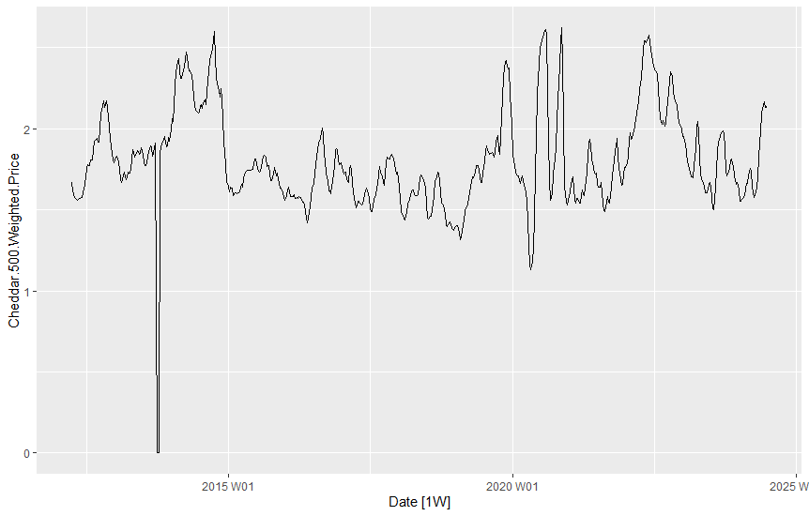
Cheddar (500 lb barrel) Sales and Pricing

Slide 11
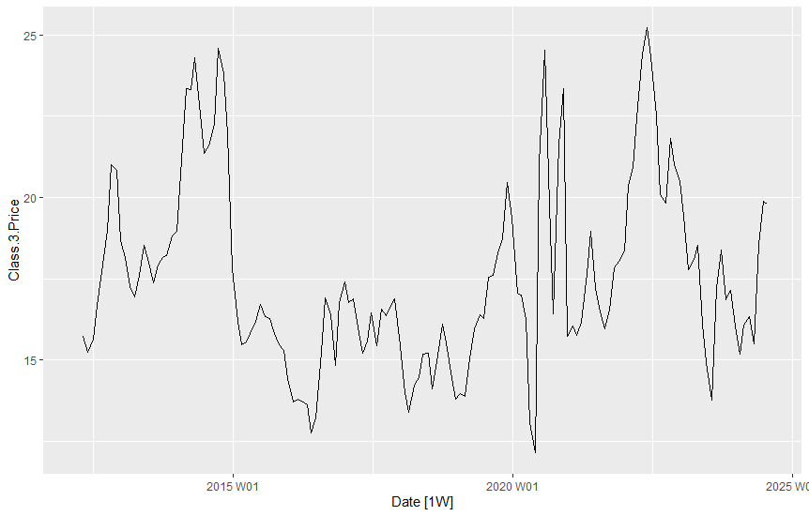
Class III Milk Pricing and Cheddar Cheese

Slide 12
Cheddar Cheese Sales
Weekly demand for Cheddar Cheese remains strong across the period of observation
This makes sense given that dairy demand tends to be relatively inelastic
The 40 lb block Cheddar sales and 500 lb barrel sales (and 500 lb barrel prices) have a structural break in the early 2010s that is likely a database pull error, though we should definitely investigate this further.
Weekly demand for 500 lb barrel seems to have a slight upward trend through the late 2010s indicating an increase in demand, perhaps processed cheese (Kraft slices, etc.) saw an uptick in popularity.
Weekly demand for 40 lb block seems fairly stable for the last decade, with no clear trend in sales.
If we want to investigate the seasonality of these series, we could decompose them or aggregate up to the monthly level to make visual inspection easier.

Slide 13
Class III Milk Pricing and Cheddar Cheese
There is clearly a relationship between Class III Milk pricing and Cheddar Cheese pricing, which is as expected!
Since 40 lb block and 500 lb barrel Cheddar Cheese prices are inputs to the Class III Milk Pricing formula, we would expect the data to show similar volatility.
Furthermore, we expect Cheese prices to be volatile for the same reasons Milk prices are volatile
Inelastic demand paired with a shortage of Cheese would be associated with a spike in prices for Cheddar Cheese and Class III Milk prices.
Increased demand overseas (exports) of dairy products would constrain supply in the domestic market which could also be associated with a spike in prices.
On the other hand, European producers might export dairy products to the United States which could result in a glut of dairy products in our domestic markets and thus a downward spike in prices.

Slide 14
What’s Next?
Test for stationarity (KPSS, ADF)
Test for structural breaks (Chow)
Decompose series (STL, Classical Decomposition)
Forecast series (SARIMA)

